Slide 1
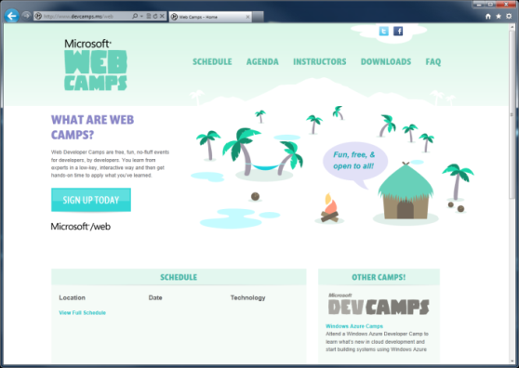

WebCamps Online
Twitter: Follow @webcamps Hashtag #webcamps
SPEAKER NAME/HANDLE HERE
Website: http://www.devcamps.ms/web
What are web camps?
Web Developer Camps are free, fun, no-fluff events for developers, by developers. You learn from experts in a low-key, interactive way and then get hands-on time to apply what you’ve learned.

Slide 2
Integrating Your Site with Internet Explorer 9 (& 10!)
Name
Title
Microsoft Corporation

Slide 3
Agenda
Windows and the Web
Pinned Sites
Interoperable
IE9 & HTML5
Building a Fast Web Experience
Getting Ready for Internet Explorer 10

Slide 4
Windows & the Web

Slide 5
Windows & the Web
57% of all time spent on a PC is in a browser

Slide 6
Web Browsing is Core to the Windows Experience
The browser is the stage, not the play

Slide 7
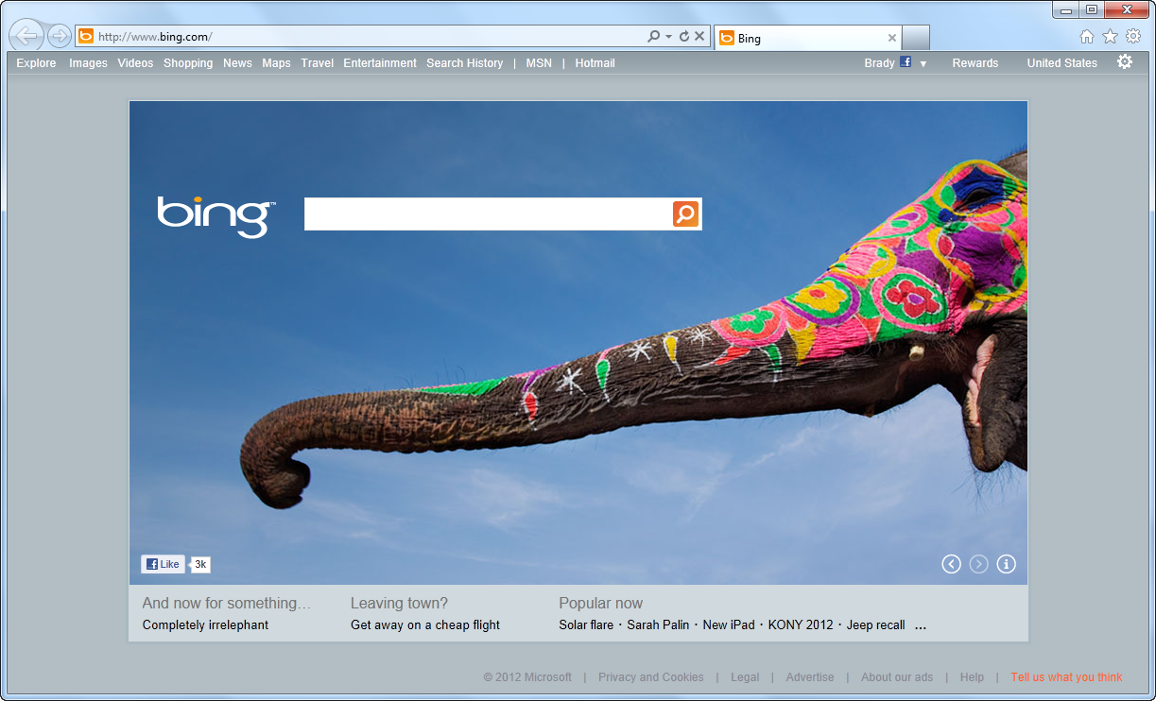
IE Puts the Focus Back on Your Site

Slide 8
Pinned Sites

Slide 9
Behind the Scenes
Pinned site execution details:
Creates an isolated instance of Internet Explorer
Generates an AppID for a specific URL
BHOs and other toolbars are not enabled
Share the same real estate as Windows applications

Slide 10
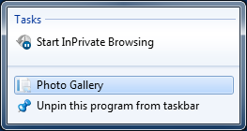
Pinning a Site Using Meta
<head>
<title>@Page.Title</title>
<meta name="application-name" content="Photo Gallery" />
<meta name="msapplication-tooltip" content="Photo Gallery" />
<meta name="msapplication-window" content="width=1024;height=768" />
<meta name="msapplication-starturl" content="http://localhost:42179/" />
</head>

Slide 11
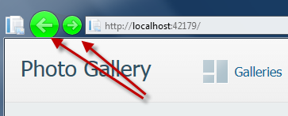
Pinning a Site Using Meta
<head>
<title>@Page.Title</title>
<meta name="application-name" content="Photo Gallery" />
<meta name="msapplication-tooltip" content="Photo Gallery" />
<meta name="msapplication-window" content="width=1024;height=768" />
<meta name="msapplication-starturl" content="http://localhost:42179/" />
<meta name="msapplication-navbutton-color" content="#00FF00" />
</head>

Slide 12
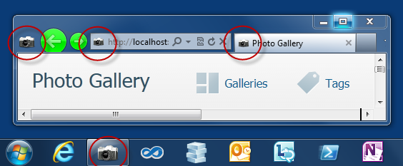
Customizing the Icon
<head>
<title>@Page.Title</title>
<meta name="application-name" content="Photo Gallery" />
<meta name="msapplication-tooltip" content="Photo Gallery" />
<meta name="msapplication-window" content="width=1024;height=768" />
<meta name="msapplication-starturl" content="http://localhost:42179/" />
<meta name="msapplication-navbutton-color" content="#00FF00" />
<link rel="shortcut icon" href="~/slr_camera.ico"/>
</head>

Slide 13
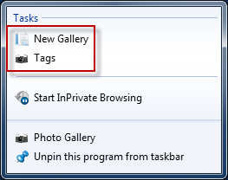
Adding a Jump List
<head>
<title>@Page.Title</title>
…
<link rel="shortcut icon" href="~/slr_camera.ico"/>
<meta name="msapplication-task" content="name=New Gallery;
action-uri=http://localhost:42179/New;
icon-uri=favicon.ico"/>
<meta name="msapplication-task"
content="name=Tags;
action-uri=http://localhost:42179/Tag;
icon-uri=slr_camera.ico"/>
</head>

Slide 14
Pinning a Site
demo

Slide 15
Interoperable

Slide 16
Working with Standards Bodies
Member of many W3C Working Groups

Slide 17
The HTML Working Group
40 W3C Member Organizations
411 group participants
280 invited experts
9 mailing lists
around 4000 emails on public-html

Slide 18
Keep Up with Standards Adoption
Internet Explorer Testing Center http://samples.msdn.microsoft.com/ietestcenter

Slide 19
IE9 & HTML5

Slide 20
HTML 5 At a Glance
Commonly used to refer to modern open web standards like HTML5, CSS3, and more
Adds new rich media and graphics support (canvas, video, audio, inline SVG…)
Standardizes behavior for browser vendors, enabling same markup

Slide 21
Canvas
A block element that allows developers to draw 2d graphics using JavaScript
Methods for drawing include: paths, boxes, circles, text and rasterized images
<canvas id="myCanvas" width="200" height="200">
Your browser doesn’t support Canvas, sorry.
</canvas>
<script type="text/javascript">
var example = document.getElementById("myCanvas");
var context = example.getContext("2d");
context.fillStyle = "rgb(255,0,0)";
context.fillRect(30, 30, 50, 50);
</script>

Slide 22
Scalable Vector Graphics (SVG)
Create and draw 2D vector graphics using XML
Vector images are composed of shapes instead of pixels
Based on the SVG 1.1 2nd Edition Full specification
Full DOM access to SVG elements
Document structure, scripting, styling, paths, shapes, colors, transforms, gradients, patterns, masking, clipping, markers, linking and views

Slide 23

SVG Code Example
A block element that allows developers to draw 2d graphics using JavaScript
Methods for drawing include: paths, boxes, circles, text and rasterized images
<svg width="400" height="200" xmlns="http://www.w3.org/2000/svg">
<rect fill="red" x="20" y="20" width="100" height="75" />
<rect fill="blue" x="50" y="50" width="100" height="75" />
</svg>

Slide 24
HTML 5 <video>
Support for the HTML5 <video> element
Industry-standard MPEG-4/H.264 video
Video can be composited with anything else on the page
HTML content, images, SVG graphics
Hardware accelerated, GPU-based decoding

Slide 25
HTML 5 <video> Attributes
src – specifies the location to pull the source file
autoplay – if present starts playing as soon as it’s ready
controls – if present displays controls
preload – if present loads source at page load
loop – if present loops back to the beginning of the video
height & width – specifies the height & width of the player
<video src="video.mp4" id="videoTag" width="640px" height="360px">
<!-- Only shown when browser doesn’t support video -->
<!-- You Could Embed Flash or Silverlight Video Here -->
</video>

Slide 26
HTML 5 <audio>
Industry-standard MP3 and AAC audio
Fully scriptable via the DOM
Attributes
src – specifies the location to pull the source file
autoplay – if present starts playing as soon as it’s ready
controls – if present displays controls
preload – if present loads source at page load
<audio src="audio.mp3" id="audioTag" autoplay controls>
<!-- Only shown when browser doesn’t support audio -->
<!-- You could embed Flash or Silverlight audio here -->
</audio>

Slide 27
Fonts & @font-face
Web Open Font Format allows you to package and deliver fonts as needed, per site
Designed for web use with the @font-face declaration
<style type="text/css">
@font-face {
font-family:MyFontName;
src: url('FontFile.woff');
}
</style>
<div style="font: 24pt MyFontName, sans-serif;">
This will render using MyFontName in FontFile.woff
</div>

Slide 28
CSS3 Media Queries
Selectively style page based on properties of the media
<style type="text/css">
@font-face {
font-family:MyFontName;
src: url('FontFile.woff');
}
</style>
<div style="font: 24pt MyFontName, sans-serif;">
This will render using MyFontName in FontFile.woff
</div>

Slide 29
CSS3 Colors
Alpha color with rgba() and hsla() color functions
Transparency control with the opacity property
Can be used with any property that takes the color property
div.top {
background-color: rgba(0, 0, 0, 0.5);
color: azure;
}
div.bottom {
background-color: hlsa(0, 0%, 0%, 0.5);
color: cornsilk;
}

Slide 30
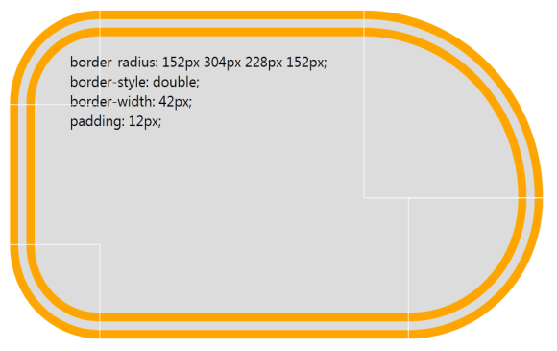
CSS3 Backgrounds & Borders
Round corners with the border-radius property
Multiple background images per element
Box-shadow property on block elements
div {
border-radius: 152px 304px 228px 152px;
border-style: double;
border-width: 42px;
padding: 12px;
}

Slide 31
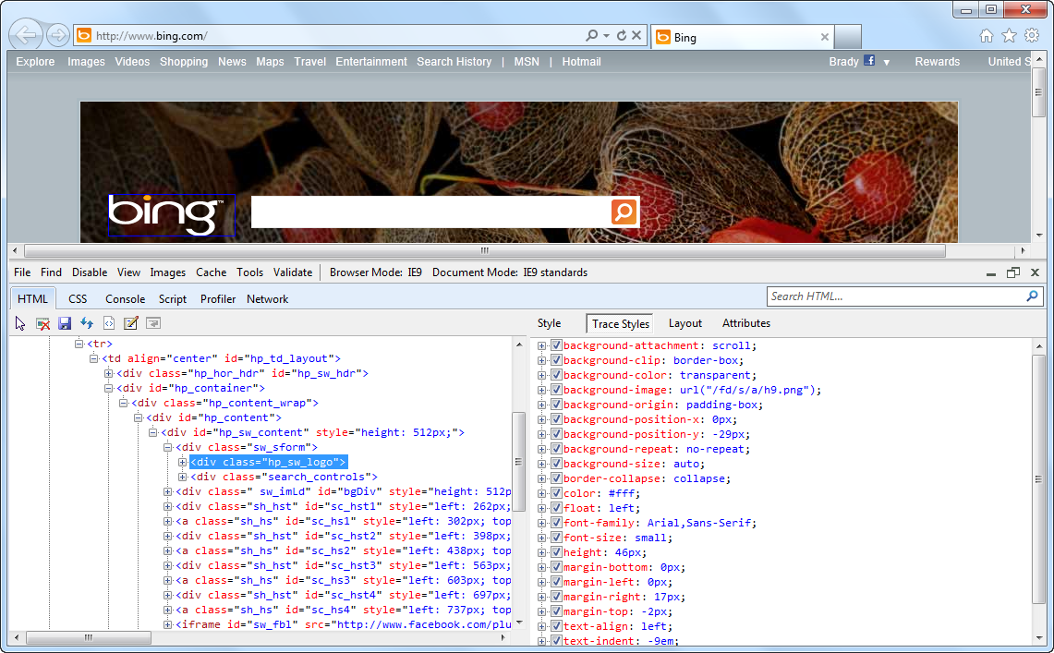
1 Key Press (F12) Developer Tools

Slide 32
Building a Fast Web Experience

Slide 33
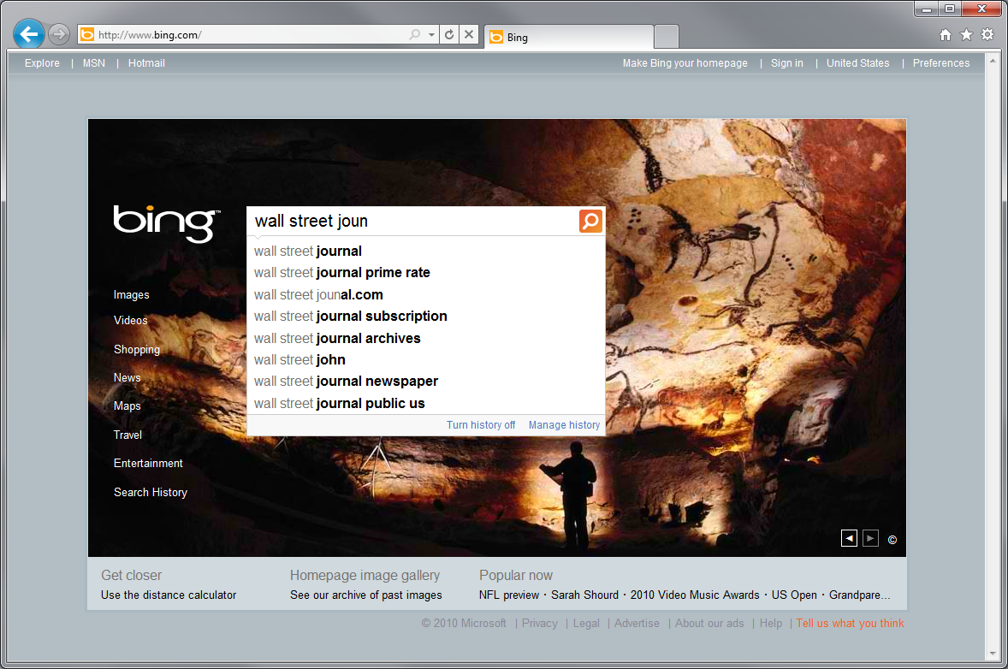
Example Scenario - The Wall Street Journal

Slide 34

Some Markup Has Been Retrieved

Slide 35
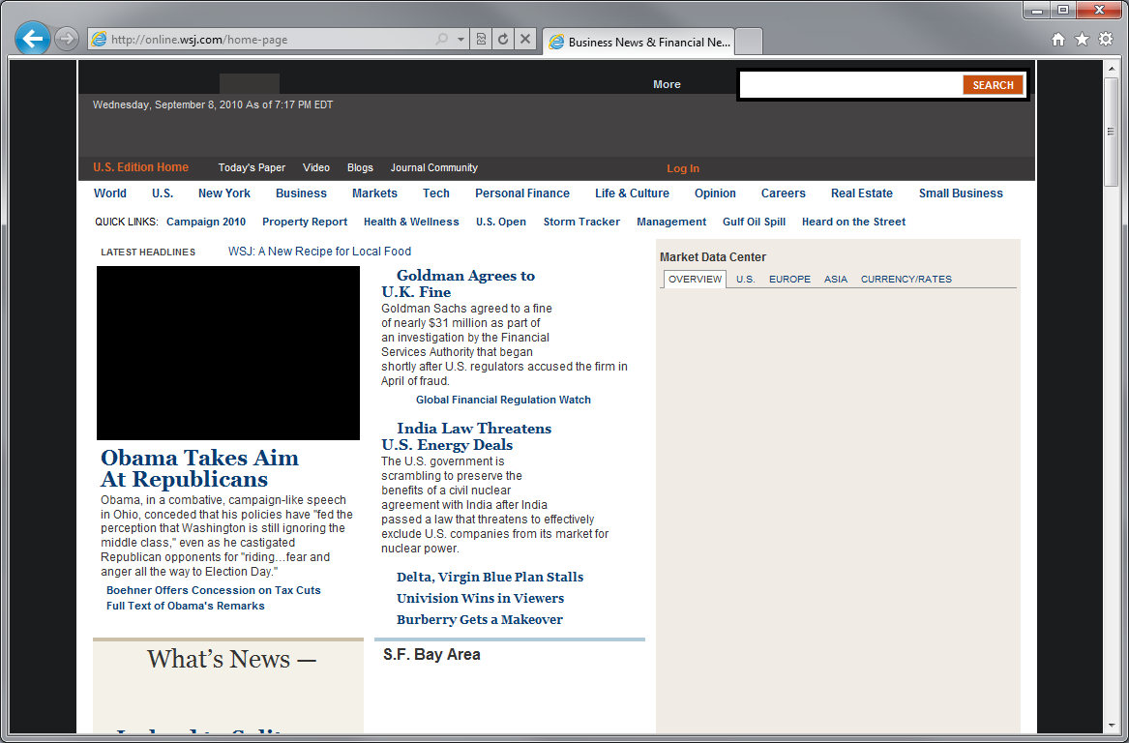
Content Starts to Render

Slide 36
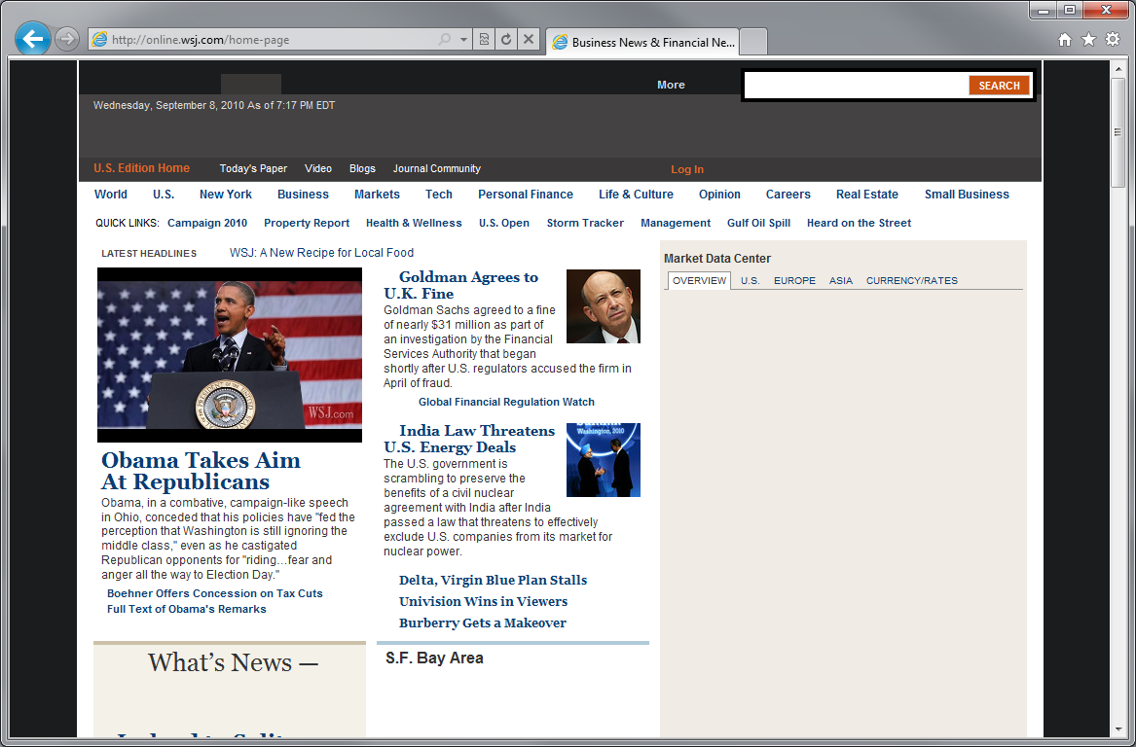
Some Images Start to Appear

Slide 37
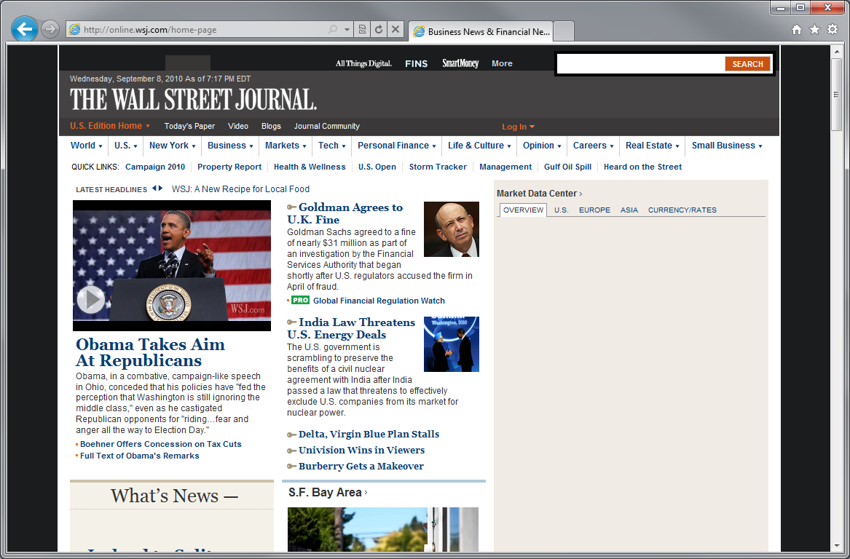
Mast Head Appears

Slide 38
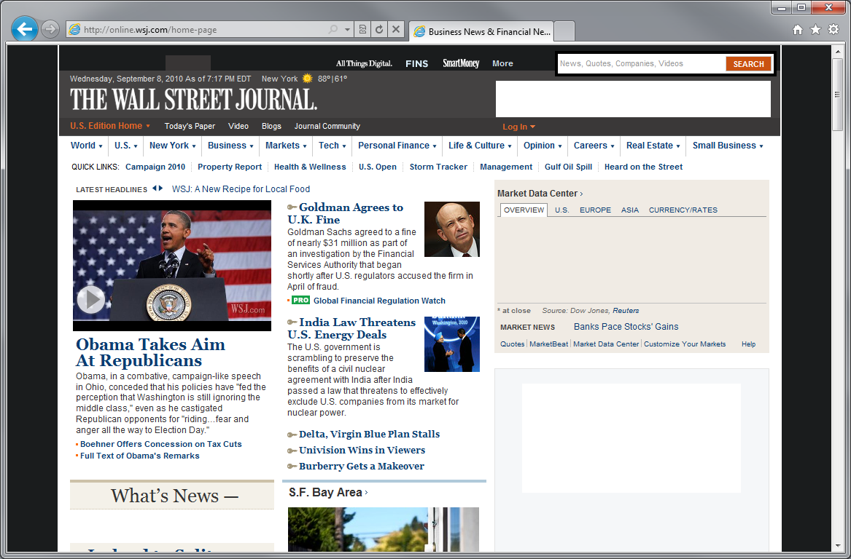
Right Column Starts to Render

Slide 39
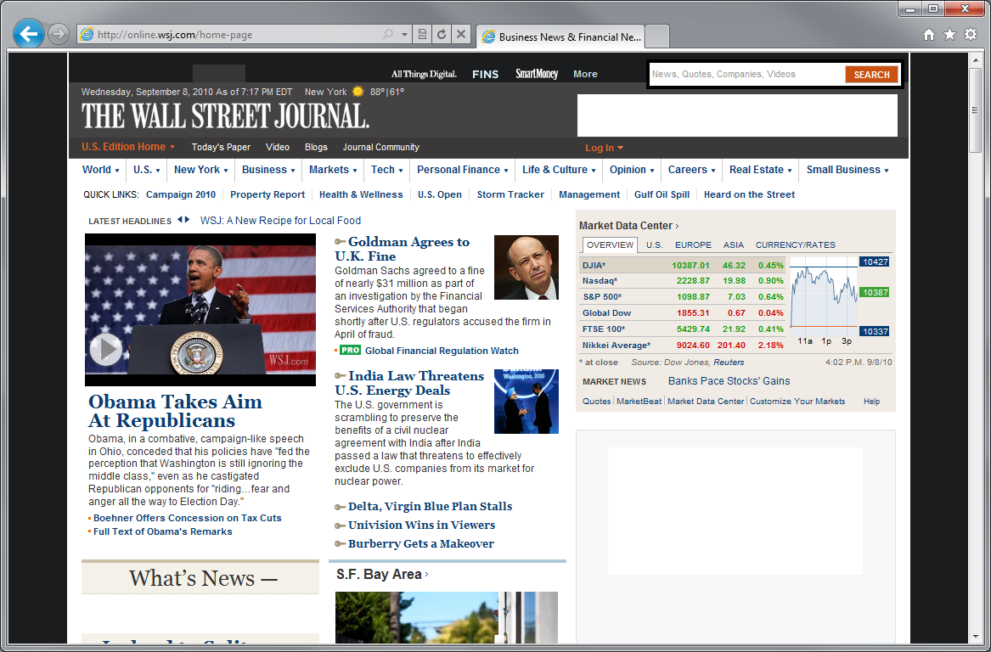
Personalized Content Starts to Appear

Slide 40

Advertisements Load

Slide 41
Done!

Slide 42

Browser Subsystems
Rendering
Layout
Block Building
Formatting
DOM
Marshalling
JavaScript
Collections
CSS
HTML
Networking

Slide 43
Picking Five Popular News Sites
Wall Street Journal
Chicago Tribune
USA Today
New York Times
Washington Post
CNN News
Seattle Times
MSN News
Financial Times
Boston Globe
News Site #1
News Site #2
News Site #3
News Site #4
News Site #5

Slide 44
Five Popular News Sites
 | Total Size | Number Elements | CSS Rules | Image Files | Script Files | Script Lines | Script Libs
News Site #1 | 3280kb | 8662 | 1293 | 137 | 21 | 14,216
News Site #2 | 961kb | 820 | 2964 | 44 | 16 | 3,812
News Site #3 | 300kb | 1187 | 1366 | 26 | 4 | 9,481
News Site #4 | 1462kb | 4257 | 893 | 76 | 21 | 11,988
News Site #5 | 2981kb | 3578 | 1917 | 88 | 19 | 20,722
JQuery
YUI
Prototype
MooTools
Scriptaculous
Other (JS Lib)

Slide 45
Five Popular News Sites
Variation in Total Size
 | Total Size | Number Elements | CSS Rules | Image Files | Script Files | Script Lines | Script Libs
News Site #1 | 3280kb | 8662 | 1293 | 137 | 21 | 14,216
News Site #2 | 961kb | 820 | 2964 | 44 | 16 | 3,812
News Site #3 | 300kb | 1187 | 1366 | 26 | 4 | 9,481
News Site #4 | 1462kb | 4257 | 893 | 76 | 21 | 11,988
News Site #5 | 2981kb | 3578 | 1917 | 88 | 19 | 20,722
JQuery
YUI
Prototype
MooTools
Scriptaculous
Other (JS Lib)

Slide 46
Five Popular News Sites
Number Elements to Number of CSS Rules
 | Total Size | Number Elements | CSS Rules | Image Files | Script Files | Script Lines | Script Libs
News Site #1 | 3280kb | 8662 | 1293 | 137 | 21 | 14,216
News Site #2 | 961kb | 820 | 2964 | 44 | 16 | 3,812
News Site #3 | 300kb | 1187 | 1366 | 26 | 4 | 9,481
News Site #4 | 1462kb | 4257 | 893 | 76 | 21 | 11,988
News Site #5 | 2981kb | 3578 | 1917 | 88 | 19 | 20,722
JQuery
YUI
Prototype
MooTools
Scriptaculous
Other (JS Lib)

Slide 47
Five Popular News Sites
Number of Images
 | Total Size | Number Elements | CSS Rules | Image Files | Script Files | Script Lines | Script Libs
News Site #1 | 3280kb | 8662 | 1293 | 137 | 21 | 14,216
News Site #2 | 961kb | 820 | 2964 | 44 | 16 | 3,812
News Site #3 | 300kb | 1187 | 1366 | 26 | 4 | 9,481
News Site #4 | 1462kb | 4257 | 893 | 76 | 21 | 11,988
News Site #5 | 2981kb | 3578 | 1917 | 88 | 19 | 20,722
JQuery
YUI
Prototype
MooTools
Scriptaculous
Other (JS Lib)

Slide 48
Five Popular News Sites
Amount of JavaScript
 | Total Size | Number Elements | CSS Rules | Image Files | Script Files | Script Lines | Script Libs
News Site #1 | 3280kb | 8662 | 1293 | 137 | 21 | 14,216
News Site #2 | 961kb | 820 | 2964 | 44 | 16 | 3,812
News Site #3 | 300kb | 1187 | 1366 | 26 | 4 | 9,481
News Site #4 | 1462kb | 4257 | 893 | 76 | 21 | 11,988
News Site #5 | 2981kb | 3578 | 1917 | 88 | 19 | 20,722
JQuery
YUI
Prototype
MooTools
Scriptaculous
Other (JS Lib)

Slide 49
Five Popular News Sites
Amount of JavaScript
 | Total Size | Number Elements | CSS Rules | Image Files | Script Files | Script Lines | Script Libs
News Site #1 | 3280kb | 8662 | 1293 | 137 | 21 | 14,216
News Site #2 | 961kb | 820 | 2964 | 44 | 16 | 3,812
News Site #3 | 300kb | 1187 | 1366 | 26 | 4 | 9,481
News Site #4 | 1462kb | 4257 | 893 | 76 | 21 | 11,988
News Site #5 | 2981kb | 3578 | 1917 | 88 | 19 | 20,722
JQuery
YUI
Prototype
MooTools
Scriptaculous
Other (JS Lib)

Slide 50
Which Sites Loads the Fastest?
 | Total Size | Number Elements | CSS Rules | Image Files | Script Files | Script Lines | Script Libs
News Site #1 | 3280kb | 8662 | 1293 | 137 | 21 | 14,216
News Site #2 | 961kb | 820 | 2964 | 44 | 16 | 3,812
News Site #3 | 300kb | 1187 | 1366 | 26 | 4 | 9,481
News Site #4 | 1462kb | 4257 | 893 | 76 | 21 | 11,988
News Site #5 | 2981kb | 3578 | 1917 | 88 | 19 | 20,722
JQuery
YUI
Prototype
MooTools
Scriptaculous
Other (JS Lib)

Slide 51
Which Sites Loads the Slowest?
 | Total Size | Number Elements | CSS Rules | Image Files | Script Files | Script Lines | Script Libs
News Site #1 | 3280kb | 8662 | 1293 | 137 | 21 | 14,216
News Site #2 | 961kb | 820 | 2964 | 44 | 16 | 3,812
News Site #3 | 300kb | 1187 | 1366 | 26 | 4 | 9,481
News Site #4 | 1462kb | 4257 | 893 | 76 | 21 | 11,988
News Site #5 | 2981kb | 3578 | 1917 | 88 | 19 | 20,722
JQuery
YUI
Prototype
MooTools
Scriptaculous
Other (JS Lib)

Slide 52
Multi-System Performance

Slide 53
Average Distribution Across 5 News Sites

Slide 54
Average Distribution Across Top AJAX Sites

Slide 55
Browser Subsystems
Rendering
Layout
Block Building
Formatting
DOM
Marshalling
JavaScript
Collections
CSS
HTML
Networking

Slide 56
Browser Subsystems
Rendering
Layout
Block Building
Formatting
DOM
Marshalling
JavaScript
Collections
CSS
HTML
Networking

Slide 57
Browser Subsystems
Rendering
Layout
Block Building
Formatting
DOM
Marshalling
JavaScript
Collections
CSS
HTML
Networking

Slide 58
Quick Caching Overview
No Response Required
First Response
GET /images/banner.jpg HTTP/1.1
Host: www.microsoft.com
HTTP/1.1 200 OK
Content-Type: image/jpeg
Expires: Fri, 30 Sep 2011 00:00:00 GMT
Second Request
No Response Required
GET /images/banner.jpg HTTP/1.1
Host: www.microsoft.com

Slide 59

Caching Improvements
Better performance, with the same markup!
HTTP Caching Improvements
DNS Improvements
Improve heuristic expiration
Support: crazy-far-futures Expires headers
Support: Vary: Accept-Encoding
Support Vary: Host
Improved scavenger
Redirect caching
Back/forward optimization
Cross-domain HTTPS revalidation mitigation
Pre-fetch based on Link Rel=Prefetch
Pre-fetch based on likely matches in ULV flyout
Pre-fetch addresses based on previous use
Fast-path for IP literals
General Improvements
Shorter User Agent String
Gracefully handle codepage restarts
Autoproxy in the frame
Img src=”” shouldn’t send a request
Issue requests on the wire earlier
Only download requires files (fonts)
Parallel Connection Improvements
Increase connections-per-proxy to 12
Speculatively pre-open additional connection
Improved LCIE connection limiting

Slide 60
Getting Ready for Internet Explorer 10

Slide 61
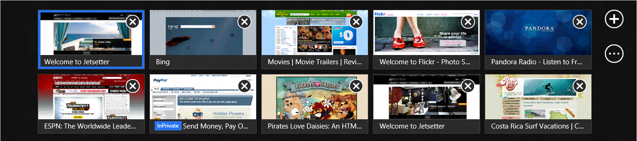
Internet Explorer 10
More standards support
Better developer tools
Built for touch in Windows 8
Notes:
Talking Track:
IE10 is about reimagining the browser in Windows 8. The web is literally edge-to-edge. This experience is optimized for touch-based devices - browser tabs and navigation controls appear and then quietly get out of the way when you don’t want them anymore.
For developers, IE10 presents new opportunities to build richer, more interactive websites while supporting many browsers and platforms:
More standards support – built with more modern web standards like HTML5 and CSS3 than ever. This allows you to write cross-browser code that works well in all modern browsers and also build metro-style apps. Better developer tools – we know it’s extra work to support the many versions of IE out there. We’ve built a new set of tools that make it easier to test your site in them and remove old markup that no longer is supported.
Built for touch in Windows 8 – make your touch-friendly site as fast and fluid as native apps. Use a singular API to support multiple input types across a range of devices.
Links:
Windows 8 Product Guide (http://msdn.microsoft.com/en-us/windows/apps/hh852650)

Slide 62
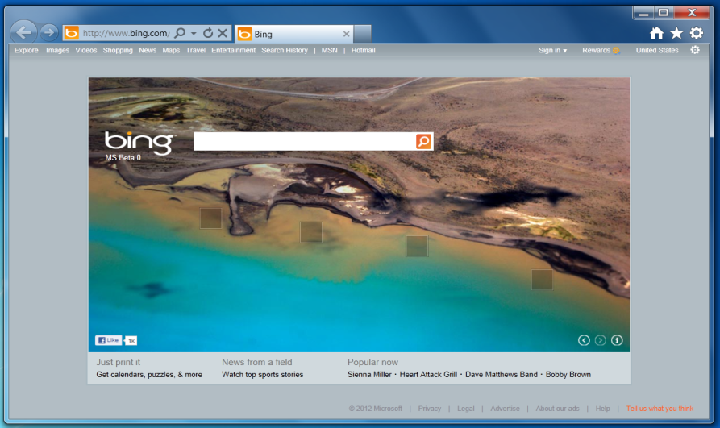
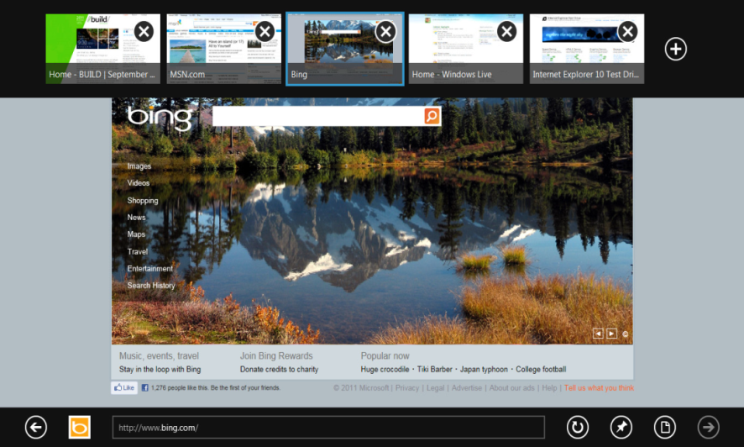
One Platform, Two Browsing Experiences
Internet Explorer
for the desktop
Internet Explorer
Notes:
Talking Track:
Windows 8 includes one HTML5 browsing engine that powers two browsing experiences in IE10 (in a touch-friendly, plug-in free metro experience and for the desktop).
A common engine is built on web standards like HTML5 and CSS3 provide allow you to write cross-browser code that works well in all modern browsers and also build metro-style apps
Links:
Web browsing in the Consumer Preview (http://blogs.msdn.com/b/b8/archive/2012/03/13/web-browsing-in-windows-8-consumer-preview-with-ie10.aspx)

Slide 63
More Standards Support

Slide 64
IE9 Hardware-Accelerated Platform
CSS 2D Transforms
CSS Backgrounds & Borders
CSS Color
CSS Fonts
CSS Media Queries
CSS Namespaces
CSS OM Views
CSS Selectors
CSS Values & Units
Data URI
DOM Element Traversal
DOM HTML
DOM Level 3 Core
DOM Level 3 Events
DOM Style
DOM Traversal & Range
DOMParser & XMLSerializer
ECMAScript 5
HTML5 Canvas
HTML5 Geolocation
HTML5 Selection
HTML5 semantic elements
HTML5 video & audio
ICC Color Profiles
Selectors API Level 2
SVG, standalone & in HTML
XHTML/XML
Notes:
Talking Track:
IE9 was a first step towards modern web standards. Our approach was to build on a stable, site-ready technologies that developers could confidently use including HTML5 Canvas, Video/Audio, SVG, and Geolocation.
IE9 also introduced the concept of a faster browser through hardware acceleration. It’s the idea that a browser can take full advantage of modern PC hardware (like a graphics card or GPU) to deliver web performance that is a good as native apps in Windows. Developers needs only write their sites with web standards to take advantage of it.
Links:
Site-ready web standards (http://blogs.msdn.com/b/ie/archive/2011/06/29/site-ready-html5-second-ie10-platform-preview-available-for-developers.aspx)
Hardware acceleration (http://blogs.msdn.com/b/ie/archive/2011/04/26/understanding-differences-in-hardware-acceleration-through-paintball.aspx)

Slide 65
IE10 Hardware-Accelerated Platform
CSS 2D Transforms
CSS 3D Transforms
CSS Animations
CSS Backgrounds & Borders
CSS Color
CSS Flexbox
CSS Fonts
CSS Grid
CSS Hyphenation
CSS Image Values (Gradients)
CSS Media Queries
CSS multi-column Layout
CSS Namespaces
CSS OM Views
CSS Positioned Floats (Exclusions)
CSS Selectors
CSS Transitions
CSS Values and Units
Data URI
DOM Element Traversal
DOM HTML
DOM Level 3 Core
DOM Level 3 Events
DOM Style
DOM Traversal and Range
DOMParser and XMLSerializer
ECMAScript 5
File Reader API
File Saving
FormData
HTML5 Application Cache
HTML5 async
HTML5 BlobBuilder
HTML5 Canvas
HTML5 Drag and drop
HTML5 Forms and Validation
HTML5 Geolocation
HTML5 History API
HTML5 Parser
HTML5 Sandbox
HTML5 Selection
HTML5 semantic elements
HTML5 track
HTML5 video and audio
JavaScript Typed Array
ICC Color Profiles
IndexedDB
Page Visibility
Pointer (Mouse, Pen, and Touch) Events
RequestAnimationFrame
Resource Timing
Selectors API Level 2
SVG Filter Effects
SVG, standalone and in HTML
Web Messaging
Web Sockets
Web Workers
XHTML/XML
XMLHttpRequest (Level 2)
XMLHttpRequest CORS
Notes:
Talking Track:
IE10 is the next step in hardware-accelerated standards with 33 new standards supported (about 220% more than IE9).
It’s easier to design your site layout including flexbox, grid, animzations, and transitions
Drag and drop, forms, and FileAPI make the web feel more like native applications
Sandbox, IndexedDB and a new set of Performance APIs help you build faster, more secure sites with large data sets
Changes between IE9 to IE10 also demonstrate how standards-based technologies evolve:
WebSockets is a great example of this, which delivers real-time notifications and updates in the browser. The spec has made significant progress in the past months in working groups like the W3C. Microsoft tests and vets specs like WebSockets in our HTML5 Labs and has contributed over 456 new test cases since IE9 launch. In this case, WebSockets was stabilized and recommended to the Internet Engineering Steering Group for final approval. It was included into IE10 through our platform previews
Links:
List of IE10 supported standards (http://msdn.microsoft.com/en-us/library/ie/hh673549(v=vs.85).aspx)
Site-ready web sockets (http://blogs.msdn.com/b/ie/archive/2011/09/15/site-ready-websockets.aspx)
HTML5 Labs (http://html5labs.interoperabilitybridges.com/)
IE Testing Center (http://samples.msdn.microsoft.com/ietestcenter/)

Slide 66
Write Cross-Browser Code
Do This…
…To get this
Declare <!DOCTYPE html>
Get rid of old markup
Implement feature detection
One UX in all modern browsers
Less time coding for IE8/7/6
Use the technologies you want
Notes:
Talking track:
We know developers want to write one markup that works reliably in all modern browsers. This frees more time to create amazing sites and takes less time supporting older browsers.
It’s a 3 step process:
You want to be as explicit as possible in telling a browsers to expect standards-based markup. Start by declaring <!DOCTYPE html>. This forces the site to enter IE10 / 9 Standards mode and helps you resolve common problems that prevent it like conditional comments or user agent sniffing of older browers.
You want your primary experience to be with modern web standards. Fallback to old versions of IE. To get rid of old markup (and off the IE Compatibility View list), run Compat Inspector, a JS library tool that automatically detects it and tells you how to fix it.
Since browsers change regularly, implement feature detection to ensure your users always have a consistent experience. Use a tool like Modernizr.
Links:
Update your docmode for web standards (http://blog.reybango.com/2012/01/09/fix-common-ie-problems-update-your-docmode-for-web-standards/)
Compat Inspector (http://ie.microsoft.com/testdrive/HTML5/CompatInspector/)
Modernizr (http://www.modernizr.com)

Slide 67
Better Developer Tools

Slide 68
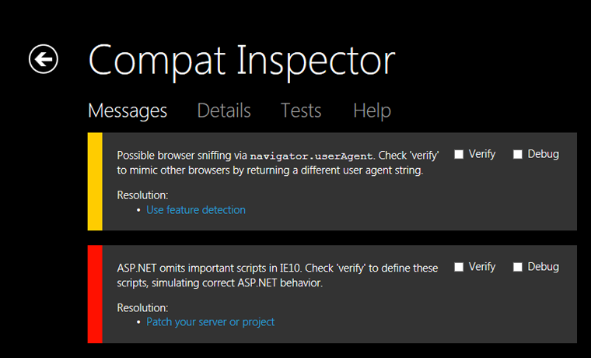

Use Compat Inspector
JS library + Fiddlr = automatic old markup detection
Notes:
Talking Track:
One of the biggest pain points for developers is supporting old versions of IE which are not based on modern web standards.
There are two things we need to do to move the web forward:
Update people’s browsers. Microsoft began implementing automatic updates for IE6/7/8 last October for those that opt-in.
Help developers get rid of old markup to emit standards-based markup. To bridge this change, IE created the Compatibility View list. This helps ensure users have a minimally good experience if it’s serving old markup. When sites are ready, it’s a simple switch to IE Standards Mode.
Compat Inspect is a JS library that can be added when you test your site. It’s the quickest way to get rid of this old markup and get to cross-browser coding.
On easy way to do this is by adding it to your Fiddler Script to adjust inject it onto pages you visit.
Links:
Auto-Updates (http://windowsteamblog.com/ie/b/ie/archive/2011/12/15/ie-to-start-automatic-upgrades-across-windows-xp-windows-vista-and-windows-7.aspx)
Compat Inspector (http://blogs.msdn.com/b/ie/archive/2012/01/20/ie10-compat-inspector.aspx)
Fiddler (http://www.fiddler2.com/fiddler2/)

Slide 69
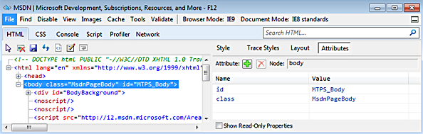
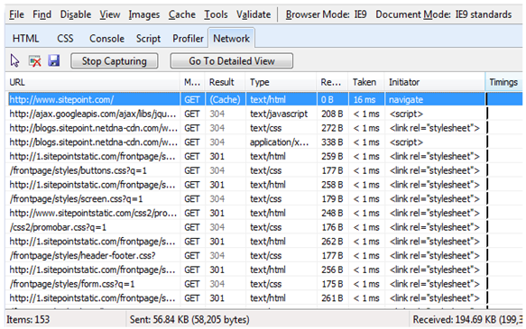
Try the F12 Developer Tools
Inspect, edit, and save HTML and CSS elements at one-click
Change rendering engines between standards-based and old markup
Debug script performance and get real-time network diagnostics
Notes:
Talking Track:
If you haven’t tried the F12 Developer tools in IE10 or 9, maybe it’s time to take a second look.
Since launching them in IE8, the suite has evolved into a powerful set client-side, cross-browser debugging tools. IE9 added real-time performance monitoring and one-click inspection of your HTML and CSS elements. You can also change between standards-based and older rendering engines which makes it easier to support older versions of IE.
IE10 builds on the work in IE9 with a new File Picker that allows you to organize and debug a large number of scripts. In debugging mode, the tools can break on caught exceptions which makes it easier for you to test.
The most important takeaway is to check to make sure your site is rendering in Standards Mode. You can see this in the top navigation of the F12 Developer Tools <here>. For example, if you currently see “Quirks” or “Emulate IE8” it means IE10 thinks you’re emitting older markup or that it’s on the Compatibility View (CV) list. Update your docmode and run Compat Inspector to fix this.
Links:
How to use F12 Developer Tools (http://msdn.microsoft.com/en-us/library/IE/gg589507(v=vs.85).aspx)
Hacking with F12 Developer Tools (http://channel9.msdn.com/events/mix/mix11/HTM18)
Debug Faster with F12 Developer Tools (http://www.sitepoint.com/debug-faster-with-f12-developer-tools-in-internet-explorer-9/#fbid=i0K0y7FaJgq)

Slide 70
Cross-Browser Web Standards
demo
Notes:
Great demos for cross-browser coding:
Show how-to declare a well-formed docmode using F12 developer tool to show IE10 / 9 Standards Mode (http://blog.reybango.com/2012/01/09/fix-common-ie-problems-update-your-docmode-for-web-standards/)
Show how-to run Compat Inspector with Fiddlr (http://blogs.msdn.com/b/ie/archive/2012/01/20/ie10-compat-inspector.aspx)
Hands-On CSS Platform (http://ie.microsoft.com/testdrive/Graphics/hands-on-css3/)
Walkthrough F12 Developer Tools like this (http://channel9.msdn.com/events/mix/mix11/HTM18)
Technology-specific @ IETestDrive (http://ie.microsoft.com/testdrive/)

Slide 71
Built for Touch in Windows 8

Slide 72
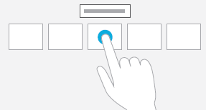
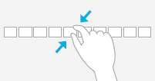

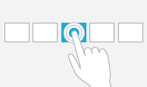
Touch first UI
Use the MSPointers API to create multi-touch input for many devices
Press & Hold to Learn
Pinch to Stretch/Zoom
Turn to Rotate
Tap for Primary Action
Get the metro app
Pin this site
Back
Auto-complete touch keyboard
Refresh
Tools
Forward
Notes:
Talking Track:
The touch-first UI in IE10 is designed for your users to easily navigate within your site and between sites. This “new language of touch” is common across Windows 8 metro apps and sites in IE10.
In-browser navigation appears when you gesture and gets out of the way when you don’t need it. There are many ways to navigate between pages:
Back, Forward, Refresh buttons in the navigation bar
Swipe on the left or right side of the page to switch between sites (and apps)
A list of recent or pinned sites pops down to explore
A pop-up keyboard with auto-complete and search
You make your site touch-friendly, use the MSPointersAPI to support multiple forms of input (like mouse, gesture, pen). This allows you to support many devices including desktops, laptops, and tablets in one step. Since many of you also support iPad touch, we’ve created a case study that can help you easily convert it to work in the many touch-enabled browsers. Search for “how-to convert my iOS touch experience to IE10 metro.”
Links:
Touch Input for IE10 and Metro style Apps (http://blogs.msdn.com/b/ie/archive/2011/09/20/touch-input-for-ie10-and-metro-style-apps.aspx)
How to convert my iOS touch experience to IE10 metro (TBD)
Touch Effects (http://ie.microsoft.com/testdrive/Graphics/TouchEffects/)

Slide 73
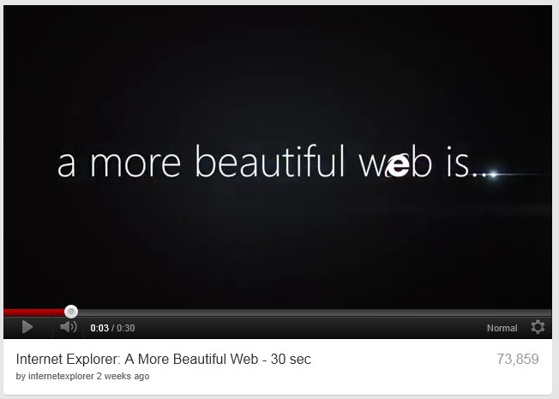

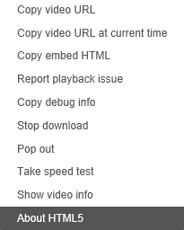
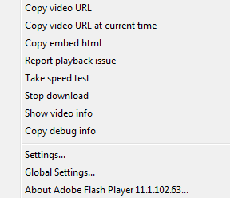
Plug-in Free Browsing
Develop a faster, consistent, and more secure user experience for rich media:
Feature detect plug-in free:
Fallback gracefully:
Notes:
Talking Track:
IE10 in the metro style experience is plug-in free. Almost all phones and tablet-based devices are already plug-in free and many sites have created a browsing experience for them. Going plug-in free offers many benefits for your users including faster load-times and a more secure browsing experience. For developers, they make it easier to provide a consistent experience across many browsers.
You should decide whether going plug-in free makes sense for your business goals and site. Some scenarios in rich media like video streaming and DRM are supported by plug-ins and still evolving in HTML5.
A best practice is to use feature detection to serve an HTML5 video experience and fallback to Flash gracefully.
If you site requires plug-ins and must continue to, you can implement a meta-tag that prompts the user to switch to Internet Explorer for the desktop.
Links:
Browsing without Plug-Ins (http://blogs.msdn.com/b/ie/archive/2011/08/31/browsing-without-plug-ins.aspx)
Meta-tag switch to Internet Explorer for the desktop (http://blogs.msdn.com/b/ie/archive/2012/01/31/web-sites-and-a-plug-in-free-web.aspx)

Slide 74
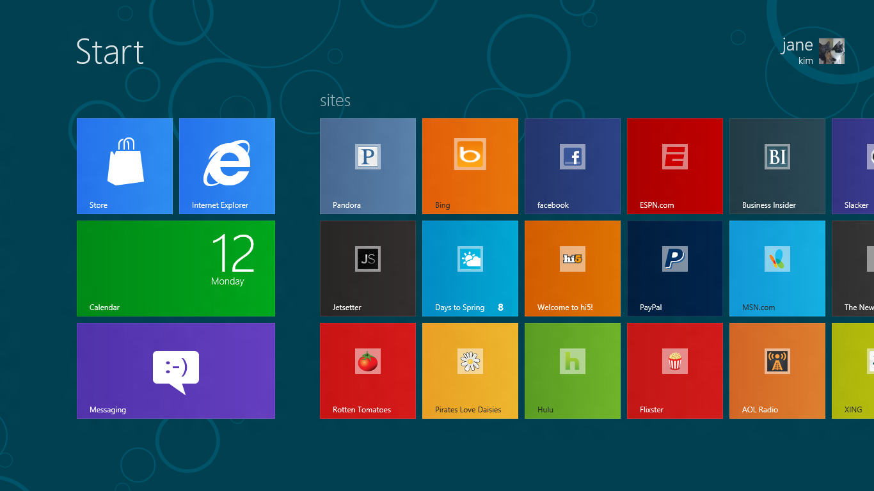


Pinning Evolved
Your site pinned to the Windows 8 start screen
Outside-of-browser notifications
Easily discovered by your users
Notes:
Talking Track:
IE9 introduced the idea that sites can feel more like native applications in Windows 7. This began with the idea that sites can have their logo right on the taskbar. Many top sites like Huffington Post, Flixster, and Gilt got an average of 50% more engagement (like time of site, page depth, repeat visits) when users pin their site. We created tools on BuildMyPinnedSite.com to help make this easier for developers to code this in a few minutes.
IE10 is pinning evolved for Windows 8. Now your sites sits right with native and metro-style apps on the Windows 8 Start Screen. The favicons and jumplists you created for IE9 light-up on IE10 too. You can use outside-of-browser notifications to catch your user’s attention even when the site is not open or active.
Most importantly, pinning is easily discovered in the metro browser at one-click. You not longer need to prompt your users to drag an icon or site tab to pin.
Links:
Web browsing in Windows 8 (http://blogs.msdn.com/b/b8/archive/2012/03/13/web-browsing-in-windows-8-consumer-preview-with-ie10.aspx)
IE10 pinning in Windows 8 test drive (http://ie.microsoft.com/testdrive/Browser/SitePinningInWin8/)
BuildMyPinnedSite (http://www.buildmypinnedsite.com)

Slide 75
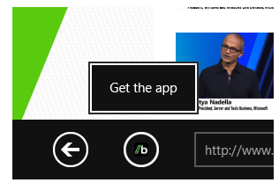
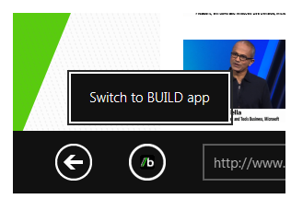
Your Metro App Discovered
Connect your app to your site in two lines of code:
Users switch from browser to app at one-click
<metaname="msApplication-ID"content="microsoft.build.App"/>
<metaname="msApplication-PackageFamilyName"content="microsoft.build_8wekyb3d8bbwe"/>
Notes:
Talking Track:
Finally, IE10 allows your users to easily get the metro app you’ve built for Windows 8. You can link the two with a couple lines of code, prompting the user to go to the marketplace and try or buy. You can also easily switch between the app and site.
Sites make money in different ways than apps like subscriptions, ads, and secure purchases. This offers a “no compromise” opportunity for users to interact with either experience according to your business goals.
Links:
Connect your website to a metro app (http://msdn.microsoft.com/en-us/library/IE/hh781489(v=vs.85).aspx)

Slide 76
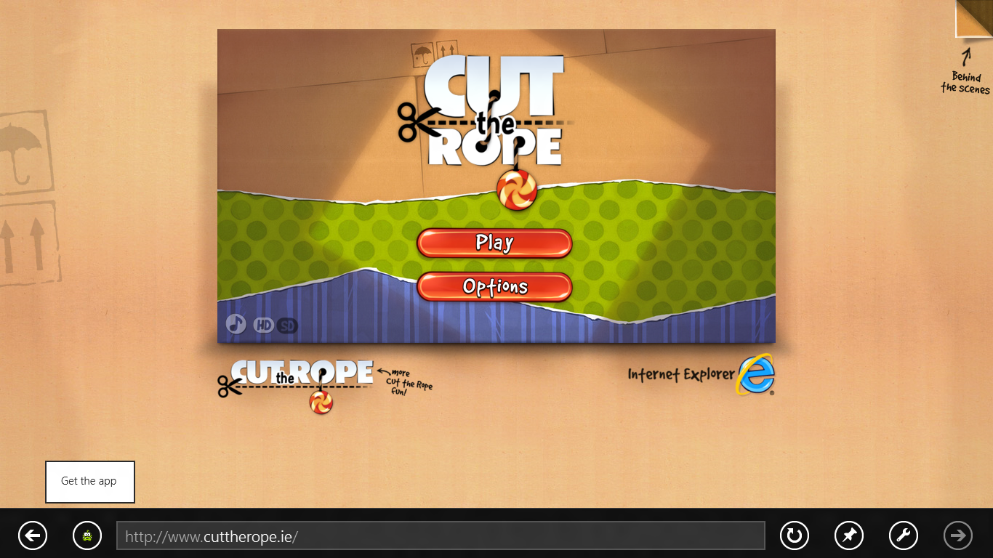
Cut the Rope
demo
Notes:
Demo: http://www.cuttherope.ie/
Brought to life in an HTML5 standards browser for IE9. Works great in Firefox, Chrome, and IE10 too.
Uses HTML5, CSS3, and JS converted to a Windows 8 metro app in a weekend
Show the developer “behind the scenes” for code samples on how to create HTML5 games. You can also search MSDN or BuildNewGames.com to learn more.
Shows how IE10 browser features (touch-friendly, plug-in free, pinning, metro app discovery) all work together in a seamless web experience that rivals native apps

Slide 77
Hardware Accelerated Web Standards
demo
Notes:
More great demos:
Disney Tron (http://disneydigitalbooks.go.com/tron/) – SVG and canvas in a digital comic book built with IE9
World’s Biggest Pacman (http://worldsbiggestpacman.com/) – Social integration with a giant set of canvas-based game boards with IE9
Lost World’s Fairs (http://lostworldsfairs.com/) – WOFF fonts. Magnify to show how clear the font resolution is.
Hunger Games (http://thecapitoltour.pn/) – Image skewing and embedded HTML5 videos. A digital experience for movies that normally would require plug-ins.
Marchmallow people (http://www.beautyoftheweb.com/bored2death/) – sillyness in an HTML5 game with canvas.

Slide 78
Go Forth and Build HTML5 Goodness

Slide 79
What We Learned
Windows and the Web
Getting Ready for Internet Explorer 10
The browser is the stage, not the play
TBD: Need to discuss with Business Owner
Pinned Sites
Internet Explorer 10 for Developers
Creates an isolated instance of Internet Explorer
Generates an AppID for a specific URL
BHOs and other toolbars are not enabled
Share the same real estate as Windows applications
More Standards Support
Interoperable
40 W3C Member Organizations
411 group participants
280 invited experts
9 mailing lists
around 4000 emails on public-html
Better Developer Tools
IE9 & HTML5
Built for Touch in Windows 8
Commonly used to refer to modern open web standards like HTML5, CSS3, and more
Adds new rich media and graphics support (canvas, video, audio, inline SVG…)
Standardizes behavior for browser vendors, enabling same markup
Building a Fast Web Experience
Go Forth and Build HTML5 Goodness
(Content)

Slide 80
For More Information
Related sessions
Documentation & articles

Slide 81
Resources
Feedback and questions http://forums.dev.windows.com

